Slide 1
영상처리6주차 과제
학번:2024254002
성명:전창수

Slide 2
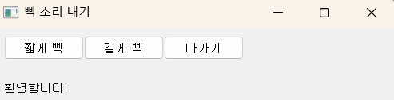
6-1
from PyQt5.QtWidgets import *
import sys
import winsound
class BeepSound(QMainWindow):
def __init__(self):
super().__init__()
self.setWindowTitle('삑 소리 내기') # 윈도우 타이틀
self.setGeometry(200, 200, 500, 100) # 윈도우 위치 및 크기
# 버튼 생성
shortBeepButton = QPushButton('짧게 삑', self)
longBeepButton = QPushButton('길게 삑', self)
quitButton = QPushButton('나가기', self)
# 라벨 생성
self.label = QLabel('환영합니다!', self)
# 버튼 위치 및 크기 설정
shortBeepButton.setGeometry(10, 10, 100, 30)
longBeepButton.setGeometry(110, 10, 100, 30)
quitButton.setGeometry(210, 10, 100, 30)
self.label.setGeometry(10, 40, 500, 70)
# 콜백 함수 연결
shortBeepButton.clicked.connect(self.shortBeepFunction)
longBeepButton.clicked.connect(self.longBeepFunction)
quitButton.clicked.connect(self.quitFunction)
def shortBeepFunction(self):
self.label.setText('주파수 1000으로 0.5초 동안 삑 소리를 냅니다.')
winsound.Beep(1000, 500)
def longBeepFunction(self):
self.label.setText('주파수 1000으로 3초 동안 삑 소리를 냅니다.')
winsound.Beep(1000, 3000)
def quitFunction(self):
self.close()
# 실행 부분
app = QApplication(sys.argv)
win = BeepSound()
win.show()
app.exec_()

Slide 3
6-2
def videoFunction(self):
self.cap = cv.VideoCapture(0, cv.CAP_DSHOW) # 카메라 연결
if not self.cap.isOpened():
self.close()
while True:
ret, self.frame = self.cap.read()
if not ret:
break
cv.imshow('video display', self.frame)
if cv.waitKey(1) & 0xFF == ord('q'):
break
def captureFunction(self):
self.capturedFrame = self.frame
cv.imshow('Captured Frame', self.capturedFrame)
def saveFunction(self):
fname, _ = QFileDialog.getSaveFileName(self, '파일 저장', './', 'Images (*.png *.jpg *.bmp)')
if fname:
cv.imwrite(fname, self.capturedFrame)
def quitFunction(self):
if hasattr(self, 'cap'):
self.cap.release()
cv.destroyAllWindows()
self.close()
# 실행 코드
app = QApplication(sys.argv)
win = Video()
win.show()
app.exec_()
from PyQt5.QtWidgets import *
import sys
import cv2 as cv
class Video(QMainWindow):
def __init__(self):
super().__init__()
self.setWindowTitle('비디오에서 프레임 수집') # 윈도우 타이틀
self.setGeometry(200, 200, 500, 100) # 창 위치와 크기
# 버튼 생성
videoButton = QPushButton('비디오 켜기', self)
captureButton = QPushButton('프레임 잡기', self)
saveButton = QPushButton('프레임 저장', self)
quitButton = QPushButton('나가기', self)
# 버튼 위치 설정
videoButton.setGeometry(10, 10, 100, 30)
captureButton.setGeometry(110, 10, 100, 30)
saveButton.setGeometry(210, 10, 100, 30)
quitButton.setGeometry(310, 10, 100, 30)
# 버튼 클릭 시 실행할 함수 연결
videoButton.clicked.connect(self.videoFunction)
captureButton.clicked.connect(self.captureFunction)
saveButton.clicked.connect(self.saveFunction)
quitButton.clicked.connect(self.quitFunction)

Slide 4
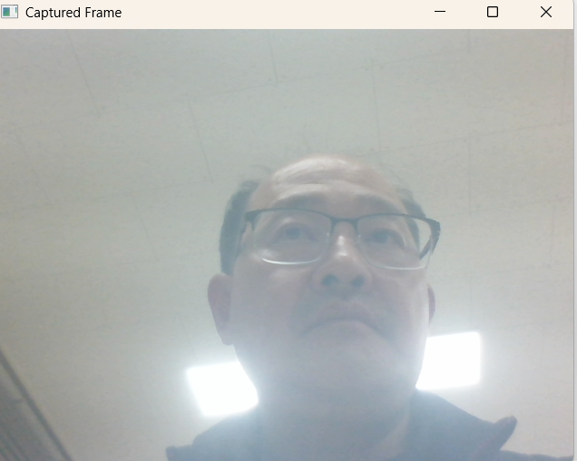
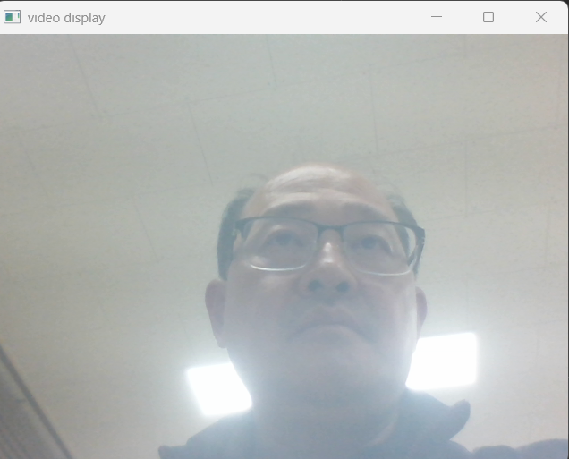
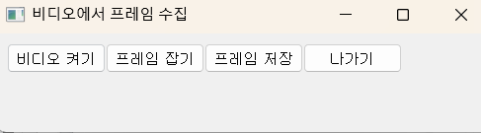

Slide 5
def paintFunction(self):
cv.setMouseCallback('Painting', self.painting)
def painting(self, event, x, y, flags, param):
if event == cv.EVENT_LBUTTONDOWN:
cv.circle(self.img_show, (x, y), self.BrushSiz, self.LColor, -1)
cv.circle(self.mask, (x, y), self.BrushSiz, cv.GC_FGD, -1)
elif event == cv.EVENT_RBUTTONDOWN:
cv.circle(self.img_show, (x, y), self.BrushSiz, self.RColor, -1)
cv.circle(self.mask, (x, y), self.BrushSiz, cv.GC_BGD, -1)
elif event == cv.EVENT_MOUSEMOVE and flags == cv.EVENT_FLAG_LBUTTON:
cv.circle(self.img_show, (x, y), self.BrushSiz, self.LColor, -1)
cv.circle(self.mask, (x, y), self.BrushSiz, cv.GC_FGD, -1)
elif event == cv.EVENT_MOUSEMOVE and flags == cv.EVENT_FLAG_RBUTTON:
cv.circle(self.img_show, (x, y), self.BrushSiz, self.RColor, -1)
cv.circle(self.mask, (x, y), self.BrushSiz, cv.GC_BGD, -1)
cv.imshow('Painting', self.img_show)
def cutFunction(self):
background = np.zeros((1, 65), np.float64)
foreground = np.zeros((1, 65), np.float64)
cv.grabCut(self.img, self.mask, None, background, foreground, 5, cv.GC_INIT_WITH_MASK)
mask2 = np.where((self.mask == 2) | (self.mask == 0), 0, 1).astype('uint8')
self.grabImg = self.img * mask2[:, :, np.newaxis]
cv.imshow('Scissoring', self.grabImg)
def incFunction(self):
self.BrushSiz = min(20, self.BrushSiz + 1)
def decFunction(self):
self.BrushSiz = max(1, self.BrushSiz - 1)
def saveFunction(self):
fname = QFileDialog.getSaveFileName(self, '파일 저장', './')
cv.imwrite(fname[0], self.grabImg)
def quitFunction(self):
cv.destroyAllWindows()
self.close()
if __name__ == '__main__':
app = QApplication(sys.argv)
win = Orim()
win.show()
app.exec_()
6-3
import cv2 as cv
import numpy as np
import sys
from PyQt5.QtWidgets import *
class Orim(QMainWindow):
def __init__(self):
super().__init__()
self.setWindowTitle('오림')
self.setGeometry(200, 200, 700, 200)
# 버튼 생성
fileButton = QPushButton('파일', self)
paintButton = QPushButton('페인팅', self)
cutButton = QPushButton('오림', self)
incButton = QPushButton('+', self)
decButton = QPushButton('-', self)
saveButton = QPushButton('저장', self)
quitButton = QPushButton('나가기', self)
# 버튼 위치 설정
fileButton.setGeometry(10, 10, 100, 30)
paintButton.setGeometry(110, 10, 100, 30)
cutButton.setGeometry(210, 10, 100, 30)
incButton.setGeometry(310, 10, 50, 30)
decButton.setGeometry(360, 10, 50, 30)
saveButton.setGeometry(410, 10, 100, 30)
quitButton.setGeometry(510, 10, 100, 30)
# 버튼 기능 연결
fileButton.clicked.connect(self.fileOpenFunction)
paintButton.clicked.connect(self.paintFunction)
cutButton.clicked.connect(self.cutFunction)
incButton.clicked.connect(self.incFunction)
decButton.clicked.connect(self.decFunction)
saveButton.clicked.connect(self.saveFunction)
quitButton.clicked.connect(self.quitFunction)
# 초기값 설정
self.BrushSiz = 5
self.LColor, self.RColor = (255, 0, 0), (0, 0, 255) # 파란색, 빨간색
def fileOpenFunction(self):
fname = QFileDialog.getOpenFileName(self, 'Open file', './')
self.img = cv.imread(fname[0])
if self.img is None:
sys.exit('파일을 찾을 수 없습니다.')
self.img_show = np.copy(self.img)
cv.imshow('Painting', self.img_show)
self.mask = np.zeros((self.img.shape[0], self.img.shape[1]), np.uint8)
self.mask[:, :] = cv.GC_PR_BGD

Slide 6
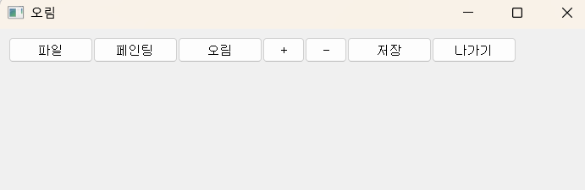
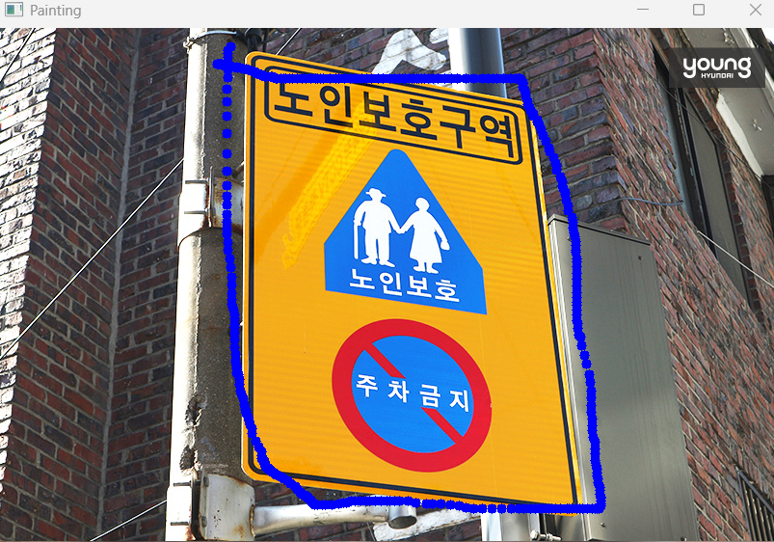
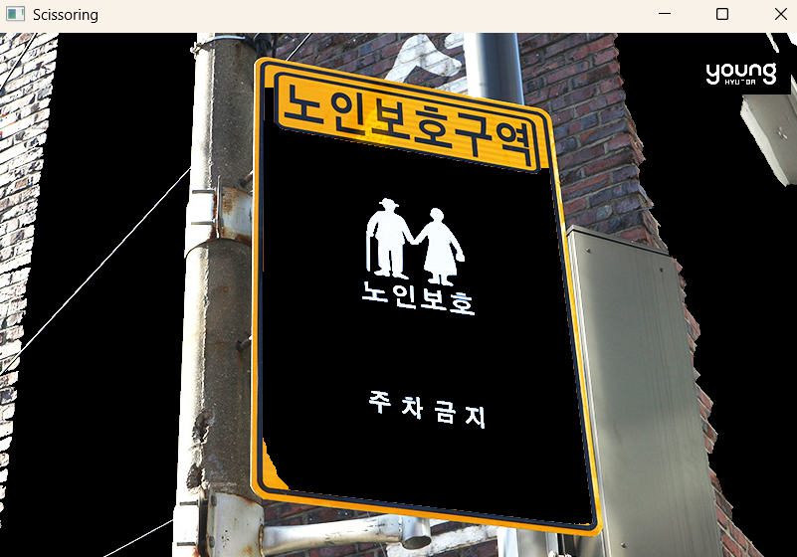

Slide 7
import cv2 as cv
import numpy as np
from PyQt5.QtWidgets import *
import sys
import winsound
class TrafficWeak(QMainWindow):
def __init__(self):
super().__init__()
self.setWindowTitle('교통약자 보호')
self.setGeometry(200, 200, 700, 200)
# 버튼 생성
signButton = QPushButton('표지판 등록', self)
roadButton = QPushButton('도로 영상 불러옴', self)
recognitionButton = QPushButton('인식', self)
quitButton = QPushButton('나가기', self)
self.label = QLabel('환영합니다!', self)
# 버튼 위치 설정
signButton.setGeometry(10, 10, 100, 30)
roadButton.setGeometry(110, 10, 100, 30)
recognitionButton.setGeometry(210, 10, 100, 30)
quitButton.setGeometry(510, 10, 100, 30)
self.label.setGeometry(10, 40, 600, 170)
# 이벤트 연결
signButton.clicked.connect(self.signFunction)
roadButton.clicked.connect(self.roadFunction)
recognitionButton.clicked.connect(self.recognitionFunction)
quitButton.clicked.connect(self.quitFunction)
# 데이터 변수 초기화
self.signFiles = [["C:\child.png", '어린이'], ["C:\elder.png", '노인'], ["C:\disabled.png", '장애인']]
self.signImgs = []
self.roadImg = None
def signFunction(self):
self.label.clear()
self.label.setText('교통약자 표지판을 등록합니다.')
self.signImgs.clear()
for fname, _ in self.signFiles:
img = cv.imread(fname)
if img is not None:
self.signImgs.append(img)
cv.imshow(fname, img)
def roadFunction(self):
if self.signImgs == []:
self.label.setText('먼저 표지판을 등록하세요.')
return
fname = QFileDialog.getOpenFileName(self, '파일 읽기', './')
self.roadImg = cv.imread(fname[0])
if self.roadImg is None:
sys.exit('파일을 찾을 수 없습니다.')
cv.imshow("C:\traffic7.jpg", self.roadImg)
def recognitionFunction(self):
if self.roadImg is None:
self.label.setText('먼저 도로 영상을 입력하세요.')
return
sift = cv.SIFT_create()
KD = [] # 표지판 키포인트/디스크립터
for img in self.signImgs:
gray = cv.cvtColor(img, cv.COLOR_BGR2GRAY)
kp, des = sift.detectAndCompute(gray, None)
KD.append((kp, des))
grayRoad = cv.cvtColor(self.roadImg, cv.COLOR_BGR2GRAY)
road_kp, road_des = sift.detectAndCompute(grayRoad, None)
matcher = cv.DescriptorMatcher_create(cv.DescriptorMatcher_FLANNBASED)
GM = [] # Good Matches 저장
for sign_kp, sign_des in KD:
knn_match = matcher.knnMatch(sign_des, road_des, 2)
T = 0.7
good_match = []
for nearest1, nearest2 in knn_match:
if nearest1.distance / nearest2.distance < T:
good_match.append(nearest1)
GM.append(good_match)
best = GM.index(max(GM, key=len)) # 가장 매칭 잘 된 표지판
img_match = cv.drawMatches(
self.signImgs[best], KD[best][0],
self.roadImg, road_kp,
GM[best], None, flags=2
)
cv.imshow('Matches and Homography', img_match)
self.label.setText(self.signFiles[best][1] + ' 보호구역입니다. 30km로 서행하세요.')
winsound.Beep(3000, 500)
def quitFunction(self):
cv.destroyAllWindows()
self.close()
# 실행
if __name__ == '__main__':
app = QApplication(sys.argv)
win = TrafficWeak()
win.show()
app.exec_()
6-4

Slide 8
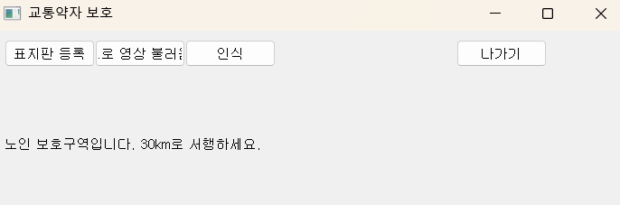
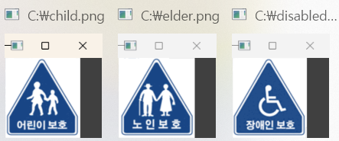
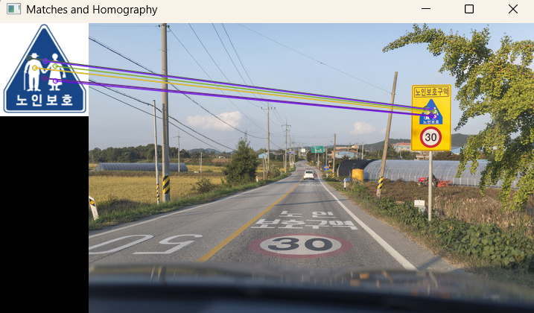

Slide 9
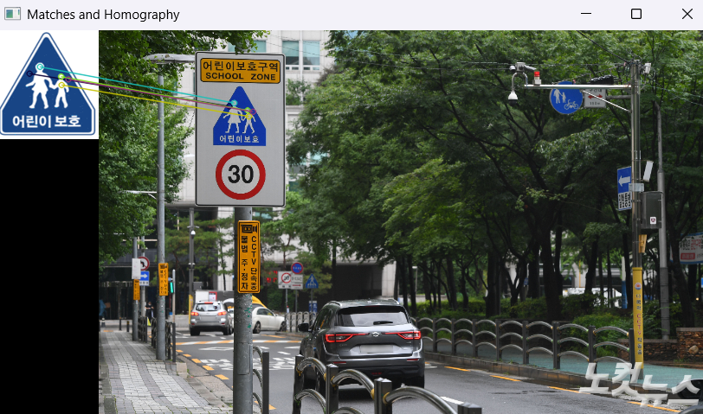
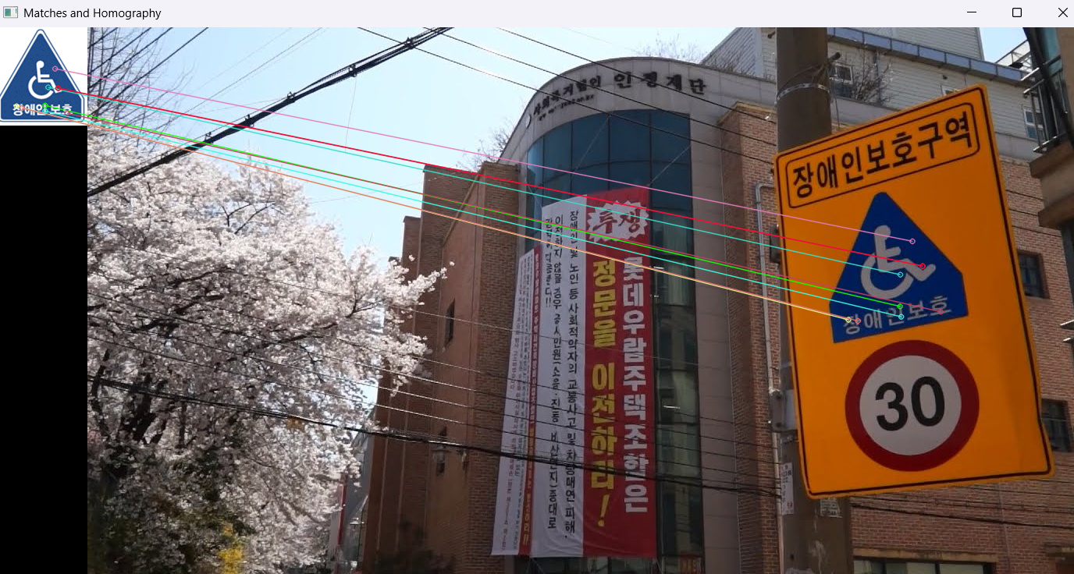

Slide 10
6-5
from PyQt5.QtWidgets import *
import cv2 as cv
import numpy as np
import winsound
import sys
class Panorama(QMainWindow):
def __init__(self):
super().__init__()
self.setWindowTitle('파노라마 영상')
self.setGeometry(200, 200, 700, 200)
# 버튼 생성
collectButton = QPushButton('영상 수집', self)
self.showButton = QPushButton('영상 보기', self)
self.stitchButton = QPushButton('봉합', self)
self.saveButton = QPushButton('저장', self)
quitButton = QPushButton('나가기', self)
self.label = QLabel('환영합니다!', self)
# 버튼 배치
collectButton.setGeometry(10, 25, 100, 30)
self.showButton.setGeometry(110, 25, 100, 30)
self.stitchButton.setGeometry(210, 25, 100, 30)
self.saveButton.setGeometry(310, 25, 100, 30)
quitButton.setGeometry(450, 25, 100, 30)
self.label.setGeometry(10, 70, 600, 170)
# 초기 비활성화
self.showButton.setEnabled(False)
self.stitchButton.setEnabled(False)
self.saveButton.setEnabled(False)
# 이벤트 연결
collectButton.clicked.connect(self.collectFunction)
self.showButton.clicked.connect(self.showFunction)
self.stitchButton.clicked.connect(self.stitchFunction)
self.saveButton.clicked.connect(self.saveFunction)
quitButton.clicked.connect(self.quitFunction)
def collectFunction(self):
self.showButton.setEnabled(False)
self.stitchButton.setEnabled(False)
self.saveButton.setEnabled(False)
self.label.setText('c를 여러 번 눌러 수집하고 끝나면 q를 눌러 비디오를 끕니다.')
self.cap = cv.VideoCapture(0, cv.CAP_DSHOW)
if not self.cap.isOpened():
sys.exit('카메라 연결 실패')
self.imgs = []
while True:
ret, frame = self.cap.read()
if not ret:
break
cv.imshow('video display', frame)
key = cv.waitKey(1)
if key == ord('c'):
self.imgs.append(frame)
elif key == ord('q'):
self.cap.release()
cv.destroyWindow('video display')
break
if len(self.imgs) >= 2:
self.showButton.setEnabled(True)
self.stitchButton.setEnabled(True)
self.saveButton.setEnabled(True)
def showFunction(self):
self.label.setText('수집된 영상은 ' + str(len(self.imgs)) + '장입니다.')
stack = cv.resize(self.imgs[0], dsize=(0, 0), fx=0.25, fy=0.25)
for i in range(1, len(self.imgs)):
stack = np.hstack((stack, cv.resize(self.imgs[i], dsize=(0, 0), fx=0.25, fy=0.25)))
cv.imshow('Image collection', stack)
def stitchFunction(self):
stitcher = cv.Stitcher_create()
status, self.img_stitched = stitcher.stitch(self.imgs)
if status == cv.STITCHER_OK:
cv.imshow('Image stitched panorama', self.img_stitched)
else:
winsound.Beep(3000, 500)
self.label.setText('파노라마 제작에 실패했습니다. 다시 시도하세요.')
def saveFunction(self):
fname = QFileDialog.getSaveFileName(self, '파일 저장', './')
if fname[0]:
cv.imwrite(fname[0], self.img_stitched)
def quitFunction(self):
if hasattr(self, 'cap'):
self.cap.release()
cv.destroyAllWindows()
self.close()
# 앱 실행
if __name__ == '__main__':
app = QApplication(sys.argv)
win = Panorama()
win.show()
app.exec_()

Slide 11
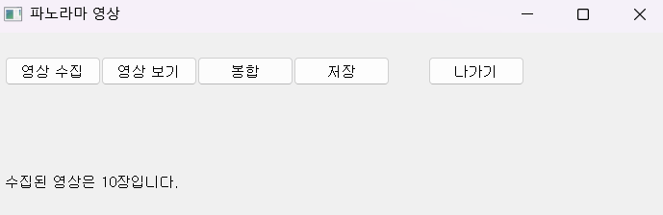
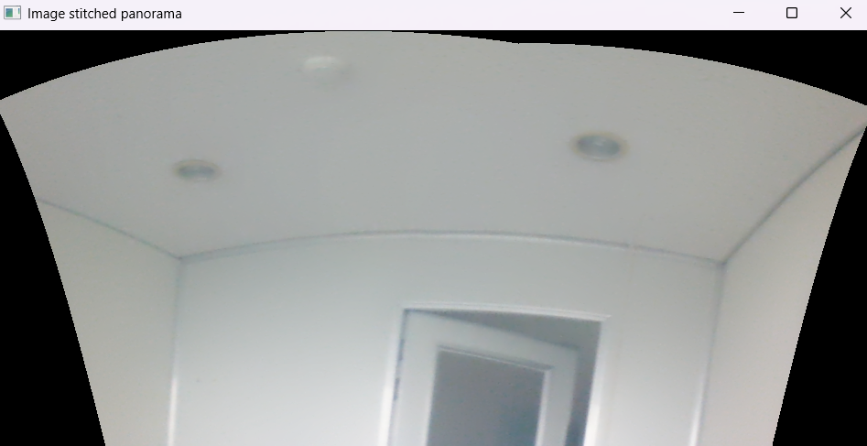

Slide 12
6-6
def pictureOpenFunction(self):
fname = QFileDialog.getOpenFileName(self, '사진 읽기', './')
self.img = cv.imread(fname[0])
if self.img is None:
sys.exit('파일을 찾을 수 없습니다.')
cv.imshow('Painting', self.img)
def embossFunction(self):
femboss = np.array([[-1.0, 0.0, 0.0], [0.0, 0.0, 0.0], [0.0, 0.0, 1.0]])
gray = cv.cvtColor(self.img, cv.COLOR_BGR2GRAY)
gray16 = np.int16(gray)
self.emboss = np.uint8(np.clip(cv.filter2D(gray16, -1, femboss) + 128, 0, 255))
cv.imshow('Emboss', self.emboss)
def cartoonFunction(self):
self.cartoon = cv.stylization(self.img, sigma_s=60, sigma_r=0.45)
cv.imshow('Cartoon', self.cartoon)
def sketchFunction(self):
self.sketch_gray, self.sketch_color = cv.pencilSketch(
self.img, sigma_s=60, sigma_r=0.07, shade_factor=0.02)
cv.imshow('Pencil sketch(gray)', self.sketch_gray)
cv.imshow('Pencil sketch(color)', self.sketch_color)
def oilFunction(self):
self.oil = cv.xphoto.oilPainting(self.img, 10, 1, cv.COLOR_BGR2Lab)
cv.imshow('Oil painting', self.oil)
def saveFunction(self):
fname = QFileDialog.getSaveFileName(self, '파일 저장', './')
i = self.pickCombo.currentIndex()
if fname[0]: # 저장 경로가 입력되었을 경우에만 저장 시도
if i == 0: cv.imwrite(fname[0], self.emboss)
elif i == 1: cv.imwrite(fname[0], self.cartoon)
elif i == 2: cv.imwrite(fname[0], self.sketch_gray)
elif i == 3: cv.imwrite(fname[0], self.sketch_color)
elif i == 4: cv.imwrite(fname[0], self.oil)
def quitFunction(self):
cv.destroyAllWindows()
self.close()
# 실행부
if __name__ == '__main__':
app = QApplication(sys.argv)
win = SpecialEffect()
win.show()
app.exec_()
import cv2 as cv
import numpy as np
from PyQt5.QtWidgets import *
import sys
class SpecialEffect(QMainWindow):
def __init__(self):
super().__init__()
self.setWindowTitle('사진 특수 효과')
self.setGeometry(200, 200, 800, 200)
# 버튼 생성
pictureButton = QPushButton('사진 읽기', self)
embossButton = QPushButton('엠보싱', self)
cartoonButton = QPushButton('카툰', self)
sketchButton = QPushButton('연필 스케치', self)
oilButton = QPushButton('유화', self)
saveButton = QPushButton('저장하기', self)
quitButton = QPushButton('나가기', self)
self.pickCombo = QComboBox(self)
self.pickCombo.addItems(['엠보싱', '카툰', '연필 스케치(명암)', '연필 스케치(컬러)', '유화'])
self.label = QLabel('환영합니다!', self)
# 버튼 위치
pictureButton.setGeometry(10, 10, 100, 30)
embossButton.setGeometry(110, 10, 100, 30)
cartoonButton.setGeometry(210, 10, 100, 30)
sketchButton.setGeometry(310, 10, 100, 30)
oilButton.setGeometry(410, 10, 100, 30)
saveButton.setGeometry(510, 10, 100, 30)
self.pickCombo.setGeometry(510, 40, 110, 30)
quitButton.setGeometry(620, 10, 100, 30)
self.label.setGeometry(10, 40, 500, 170)
# 버튼 기능 연결
pictureButton.clicked.connect(self.pictureOpenFunction)
embossButton.clicked.connect(self.embossFunction)
cartoonButton.clicked.connect(self.cartoonFunction)
sketchButton.clicked.connect(self.sketchFunction)
oilButton.clicked.connect(self.oilFunction)
saveButton.clicked.connect(self.saveFunction)
quitButton.clicked.connect(self.quitFunction)

Slide 13
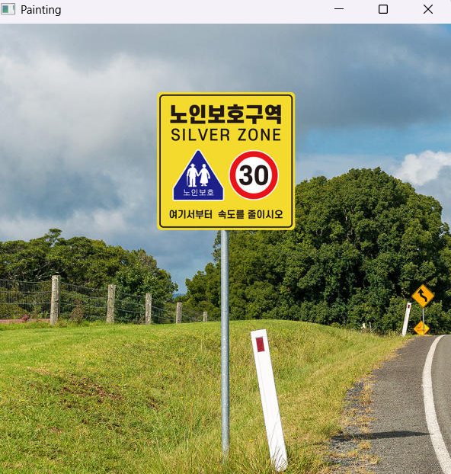
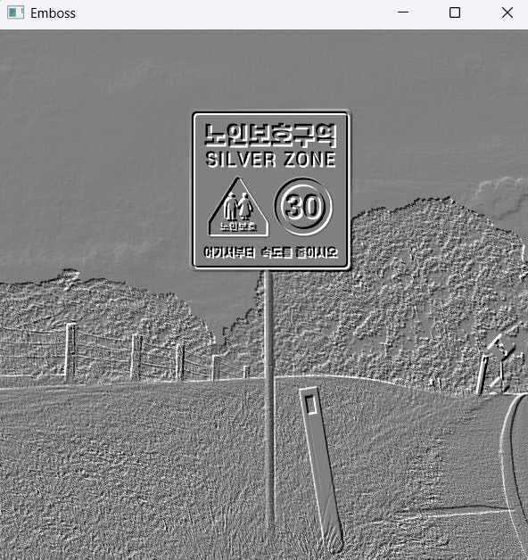
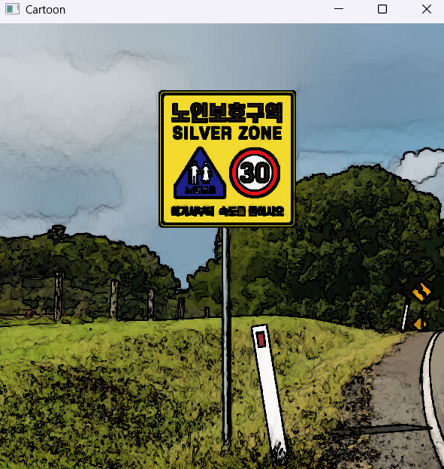
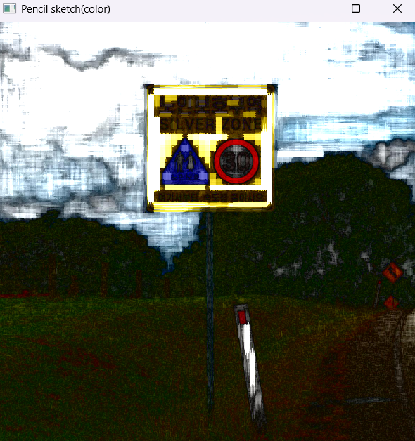
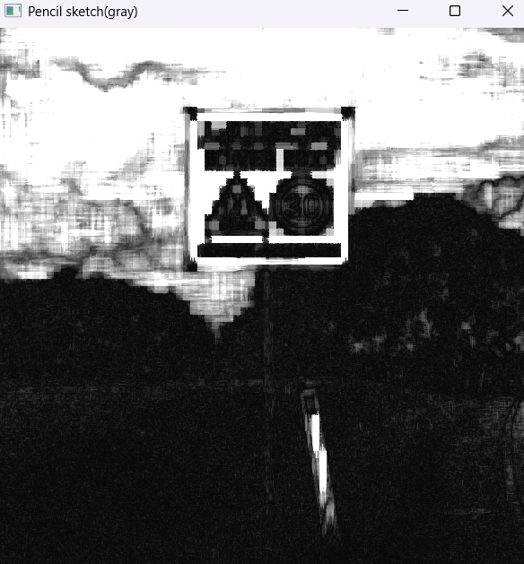

Slide 14
6-7
if pick_effect == 0:
# 엠보싱
femboss = np.array([[-1.0, 0.0, 0.0],
[0.0, 0.0, 0.0],
[0.0, 0.0, 1.0]])
gray = cv.cvtColor(frame, cv.COLOR_BGR2GRAY)
gray16 = np.int16(gray)
special_img = np.uint8(np.clip(cv.filter2D(gray16, -1, femboss) + 128, 0, 255))
elif pick_effect == 1:
# 카툰
special_img = cv.stylization(frame, sigma_s=60, sigma_r=0.45)
elif pick_effect == 2:
# 연필 스케치 (명암)
special_img, _ = cv.pencilSketch(frame, sigma_s=60, sigma_r=0.07, shade_factor=0.02)
elif pick_effect == 3:
# 연필 스케치 (컬러)
_, special_img = cv.pencilSketch(frame, sigma_s=60, sigma_r=0.07, shade_factor=0.02)
elif pick_effect == 4:
# 유화
special_img = cv.xphoto.oilPainting(frame, 10, 1, cv.COLOR_BGR2Lab)
# 결과 출력
cv.imshow('Special effect', special_img)
key = cv.waitKey(1)
if key == ord('q') or key == 27:
self.cap.release()
cv.destroyAllWindows()
break
def quitFunction(self):
if hasattr(self, 'cap'):
self.cap.release()
cv.destroyAllWindows()
self.close()
# 프로그램 실행
if __name__ == '__main__':
app = QApplication(sys.argv)
win = VideoSpecialEffect()
win.show()
app.exec_()
import cv2 as cv
import numpy as np
from PyQt5.QtWidgets import *
import sys
class VideoSpecialEffect(QMainWindow):
def __init__(self):
super().__init__()
self.setWindowTitle('비디오 특수 효과')
self.setGeometry(200, 200, 400, 100)
# 버튼 및 콤보박스 생성
videoButton = QPushButton('비디오 시작', self)
self.pickCombo = QComboBox(self)
self.pickCombo.addItems(['엠보싱', '카툰', '연필 스케치(명암)', '연필 스케치(컬러)', '유화'])
quitButton = QPushButton('나가기', self)
# 위치 지정
videoButton.setGeometry(10, 10, 140, 30)
self.pickCombo.setGeometry(150, 10, 110, 30)
quitButton.setGeometry(280, 10, 100, 30)
# 기능 연결
videoButton.clicked.connect(self.videoSpecialEffectFunction)
quitButton.clicked.connect(self.quitFunction)
def videoSpecialEffectFunction(self):
self.cap = cv.VideoCapture(0, cv.CAP_DSHOW)
if not self.cap.isOpened():
sys.exit('카메라 연결 실패')
while True:
ret, frame = self.cap.read()
if not ret:
break
pick_effect = self.pickCombo.currentIndex()

Slide 15
